Slide 1

Welcome
To the presentation of our project called
“Support Hero”
A central platform for support services
Department of CSE, 4th semester, Autumn 2025
Course Title | Software Engineering and System Analysis lab
Course Code | CSE0613226
Course Instructor | Sadia Jahan, Assistant Professor
Group Title | “Nexus Codex”
Group Members (0432410005101…) | Partho Kumar Ray Amit (070)
 | Md. Ashraful Haque Zani (075)
 | Gaus Saraf Murady (088)
 | Md. Jubair Ahammed (112)

Slide 2
Introduction
"Support Hero" system is a digital platform that connects individuals who need help (requesters) with volunteers who can offer support across multiple domains, including cleanliness, minor services, delivery assistance, and more.
Objective:
To mobilize undervalued and underprivileged civilians as valuable workforce.
1
To source funds from the wealthy and charity-minded.
2
Work alongside government organizations and NGOs with similar goals.
3
Appreciate and showcase previous achievements.
4
Build a Central Support Platform where people can ask for help and others can give help quickly.
5
Show clearly where donations go making the system trustworthy.
6
Design a cloud-based, real-time platform so that system can handle more users and stay safe all the time
7

Slide 3






Key Features of Support Hero
Diverse Services
Ecosystem Dependence
Facilitates support for essential services like Waste Management, Courier, Cleaning, and Provisional Guard services.
An interdependent ecosystem where Supporters receive help and Volunteers provide it, fostering community engagement.
AI Chat
Donation System
An integrated AI chat feature provides guidance on culture, cleanliness, and ethical practices for common support scenarios.
Enables both small and large financial contributions to support the platform's operations and specific initiatives.
Feedback Mechanism
Incentive Program
Robust feedback collection system to continuously improve service quality and user satisfaction.
A "Volunteer Bounty System" recognizes and rewards volunteers, dubbing them "Heroes" for their problem-solving efforts.

Slide 4
Functionality & System Architecture
Roles:
Core Modules:
Supporter: Submits service requests.
Home Page: Central navigation hub for all users.
Volunteer: Accepts and resolves requests.
Join Us: Role-specific onboarding for new users.
Request DB: Stores all supporter service requests.
Admin: Manages users and platform content.
Volunteer Response DB: Logs all completed volunteer tasks.
Donors: Provides financial support.
Admin DB: Manages user access and content moderation.
AI Chat: Provides suggestions and best practices.
Donation Module: Interface for financial contributions.
Logout: Securely ends user sessions.
System Architecture:
Frontend: HTML, CSS, JavaScript for dynamic interfaces.
Backend: PHP/Python for server logic and data processing.
Database: MongoDB/Firebase for scalable data storage.
Hosting: Firebase for reliable and real-time operations.

Slide 5
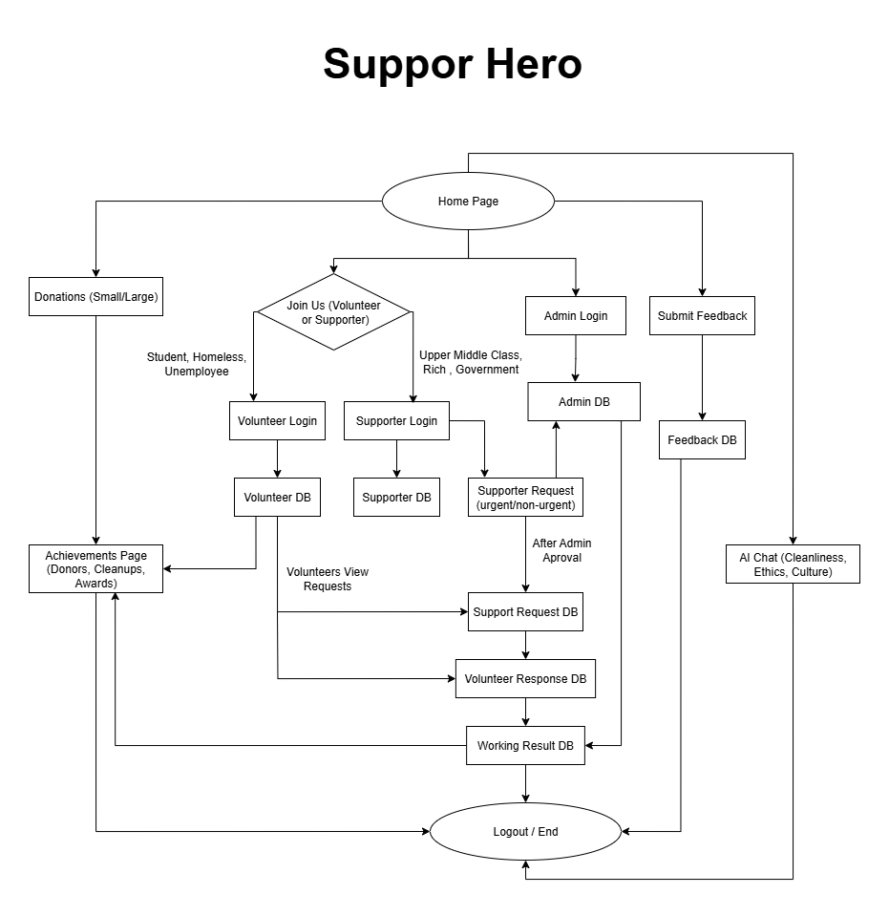

Slide 6
Team Responsibilities
Our team, Nexus Codex, is comprised of four dedicated members, each contributing specialized skills to the development of "Support Hero." Our collaborative approach ensures comprehensive coverage of all project phases, from conceptualization to implementation.
2
Partho Kumar Ray Amit
(Frontend)
Gaus Saraf Murady
(Backend, Database)
3
Md. Ashraful Haque Zani
(Frontend)
Jubair Ahammed Jubu
(Backend, Database)
4

Slide 7




User Benefits
Support Hero provides unique advantages for each user type within its ecosystem:
Supporters: Accessible & Urgent help
Volunteers: Recognition & Flexibility
Donors: Transparent Giving & Direct
Admins: Comprehensive Oversight & Metrics
Users can quickly get help from many support services. The request process is easy, so they receive help fast when they need it the most. This saves time and avoids stress.
"Volunteers, called our 'Heroes', get special recognition through a bounty reward system. They can work whenever they want, so it’s easy to help people without changing their daily routine."
"Donors can clearly see how their money is used. They can track the real results of their donations and how it helps people and improves the community."
"Admins can control the whole system. They manage users, requests, and volunteers. They also see performance data and approve activities to keep everything running smoothly and responsibly."

Slide 8

Revenue Sources (Non-Profit):
Donations (Small/Large)
Optional bounties for completed tasks, incentivizing volunteers.
Strategic NGO & CSR partnerships.
Sponsored recognition systems for volunteers.

Slide 9
Project Scope & Impact:
Characteristics:
Community-driven support model.
Real-time system for immediate interactions.
Scalable design to accommodate growth.
Directly aids vulnerable populations: homeless, students, unemployed.
Modular role-based interface for tailored experiences.
Feedback-driven for continuous improvement.
Transparent donation and action tracking.
Fosters social problem-solving with a human touch.
Builds a direct bridge between donors and service providers.
Enables real-time volunteer management for efficient deployment.

Slide 10

"Supporters call for the heroes — and they answer.”
We believe "Support Hero" can make a significant impact.
Thank you for your time.

